Slide 1

Investigating Appointment Trends, Regional Variation, and Service Efficiency in NHS Healthcare Delivery
Lakmali Amarawardana

Slide 2
Background and context of the business
Healthcare systems face fluctuating appointment demand across regions and time.
Understanding these variations is critical for efficient service delivery.
Data-driven insights can support better planning and reduce operational pressure.

Slide 3
Objectives
Identify seasonal trends Analyse patterns in appointment volumes over time to detect peak and low-demand periods.
Assess regional demand Compare appointment volumes across locations to highlight disparities and resource needs.
Improve service planning Use appointment data to optimise staffing, allocate resources effectively, and reduce system strain.

Slide 4
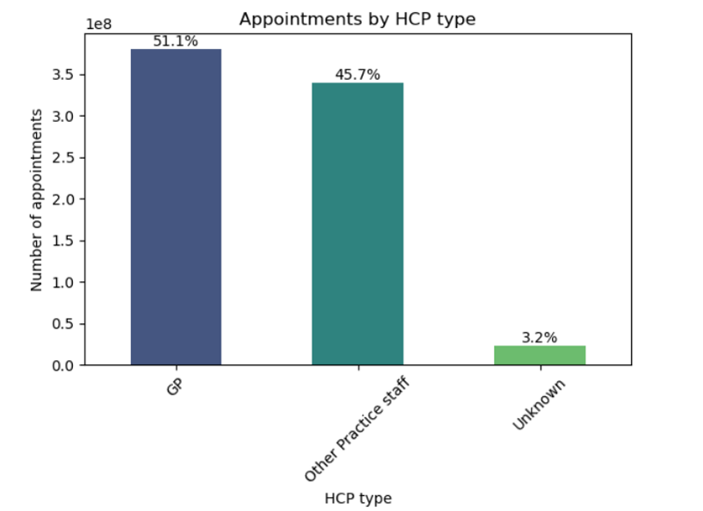
Workforce Structure
GP and Other Practice Staff deliver ~97% of all appointments
GP-led system with growing support from wider clinical staff
Minimal “Unknown” category (~3%): minor data gaps

Slide 5
Growth Demand & Pressure
Increase in appointment demand over time
Monthly fluctuations indicate unstable demand patterns
Significant variation across ICBs
Highest: ~7 million appointments
Lowest:~300K appointments
Evidence of uneven system pressure across regions
Nationally, mom decline, potential annual reduction ~1.6 million (reduction per month-134603

Slide 6
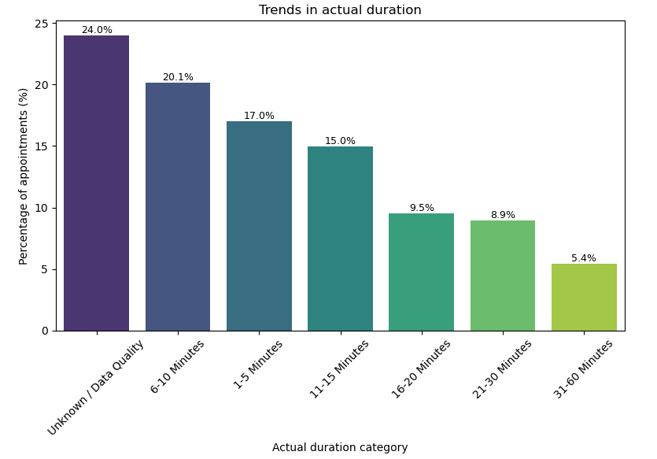
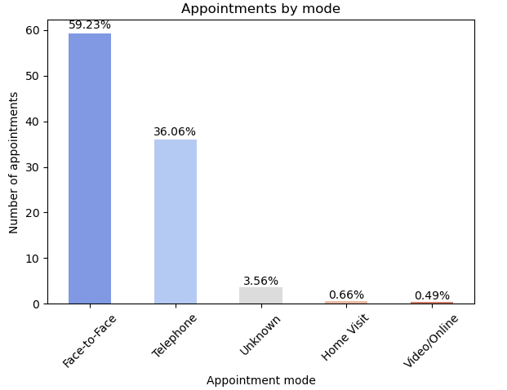
Service Delivery Patterns
Face-to-face 59% and telephone 36%
Very low use of video/online < 1%
Majority of appointments are short <15 minutes

Slide 7
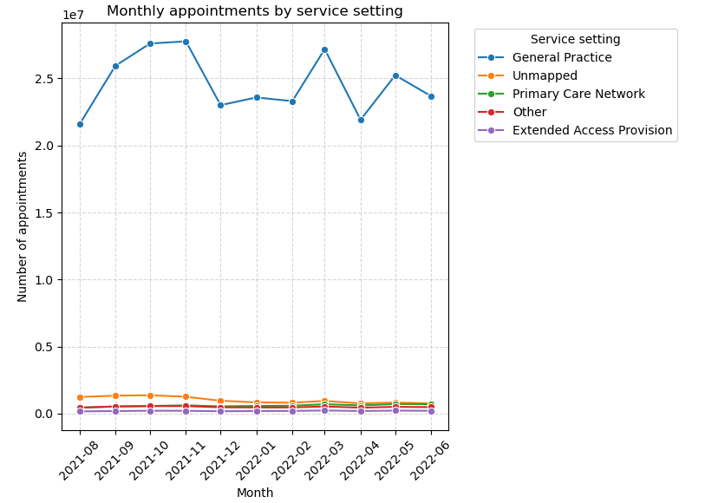
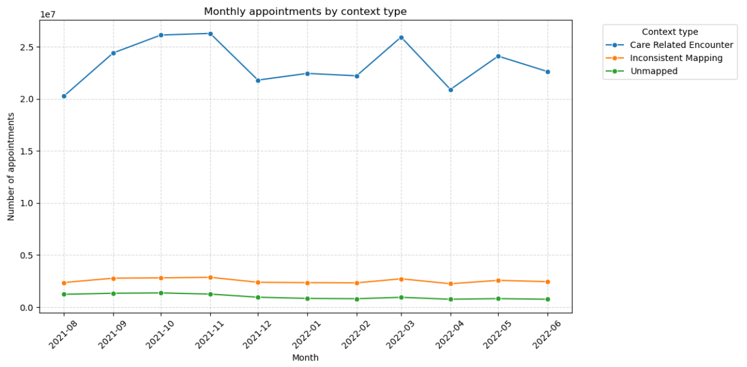
General Practice & routine consultations are the main service type
System focused on high-volume, routine care delivery

Slide 8
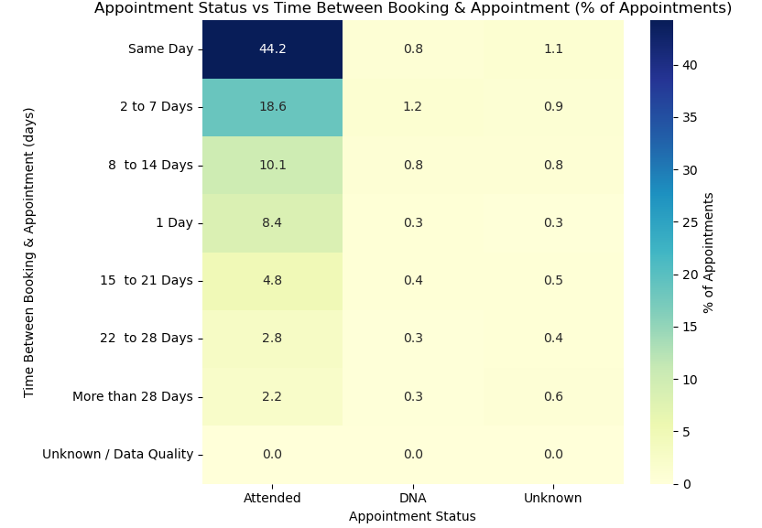
System Performance
Most appointments occur same day or within 7 days
High attendance rates, very low DNA
🔥Financial impact: ~£50.4 million lost due to missed appointments

Slide 9
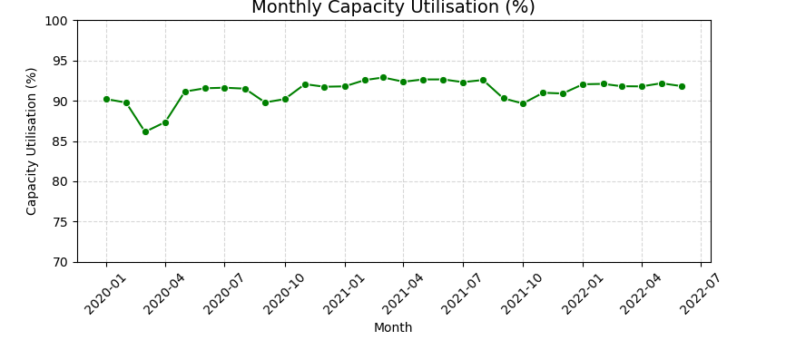
Capacity utilisation ~91% Indicate that system near full capacity

Slide 10
Tweet Analysis Overview
Tweets are mainly focused on healthcare topics, jobs, AI and medical related.
Engagement is highly uneven, most tweets receive low interaction, while a few gain very high visibility.
Sentiment is mostly positive or neutral.

Slide 11
Conclusion
NHS system is:
High demand & high utilisation
Growing pressure over time
Supported by a shared workforce model
Reliant on traditional (face-to-face) delivery
Tweets are informative but not consistently engaging or widely shared
⚠️ Data quality improvements needed for better planning

Slide 12
Recommendations
Improve workforce planning across regions
Strengthen data quality and standardisation
Support demand management strategies
Increase use of non-GP workforce
Expand digital consultation adoption
Improve capacity management in high-demand regions
Enhance service accessibility and appointment flow
Address financial inefficiency linked to missed appointments
Improve engagement by using more visual content, clear messaging and real stories

